Slide 1
Parser
Parser works on a stream of tokens.
The smallest item is a token.
source
program
Lexical Analyzer
token
Parser
parse tree
get next token

Slide 2
Syntax Analysis
Context Free Grammar (CFG)
Derivation
Concrete and Abstract syntax tree
Ambiguity

Slide 3
Formal Language
An Alphabet is a set Σ of input symbols, that act as letters
A Language over Σ is a set of strings made from symbols in Σ
When scanning, our alphabets are ASCII and we produced tokens
When parsing, our alphabets are set of tokens produced from Scanner.

Slide 4
The limit of Regular Language
Regular Expression are weak to define programing languages
Cannot define a regular expression matching all functions with properly nested block structure.
We need more powerful formalism-(CFG) Context Free Grammar which is a superset of RE.
The syntax analyzer (parser) checks whether a given source program satisfies the rules implied by a context-free grammar or not.

Slide 5
A context-free grammar
gives a precise syntactic specification of a programming language.
the design of the grammar is an initial phase of the design of a compiler.
a grammar can be directly converted into a parser by some tools.

Slide 6
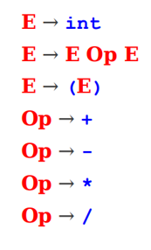
Formal Definition of CFG
CFG is a collection of 4 objects:
Set of non terminals / variables
Set of terminals
Set of production rules
Start symbol
Non Terminals: E, Op
Terminals: int, (, ), +, -, *, /

Slide 7
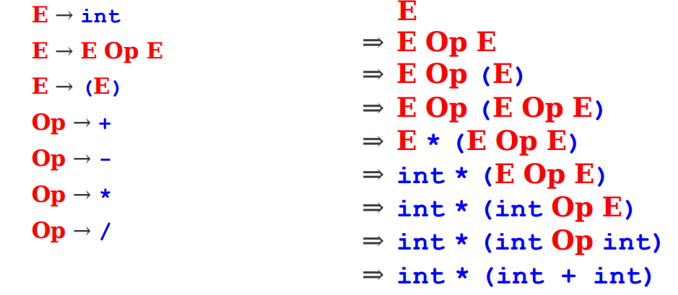
Arithmetic Expression
Suppose we want to describe all legal arithmetic expressions using addition, subtraction, multiplication, and division.
Here is one possible CFG:
Input String is: int * (int + int)

Slide 8
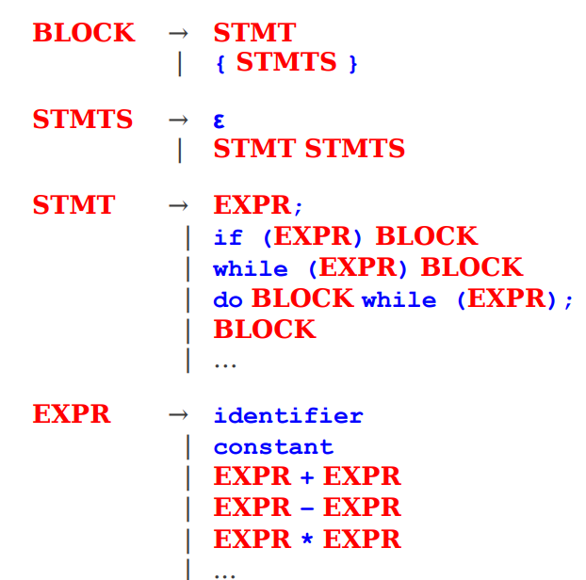
CFG for Programing Languages

Slide 9
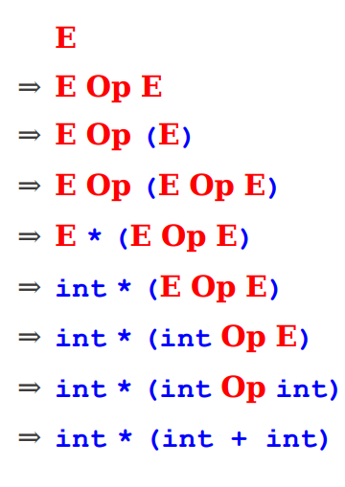
Derivations: sequence of steps to derive a string
+

Slide 10
Leftmost Derivations and Right most Derivations
A leftmost derivation is a derivation in which each step expands the leftmost nonterminal
A rightmost derivation is a derivation in which each step expands the rightmost nonterminal.

Slide 11
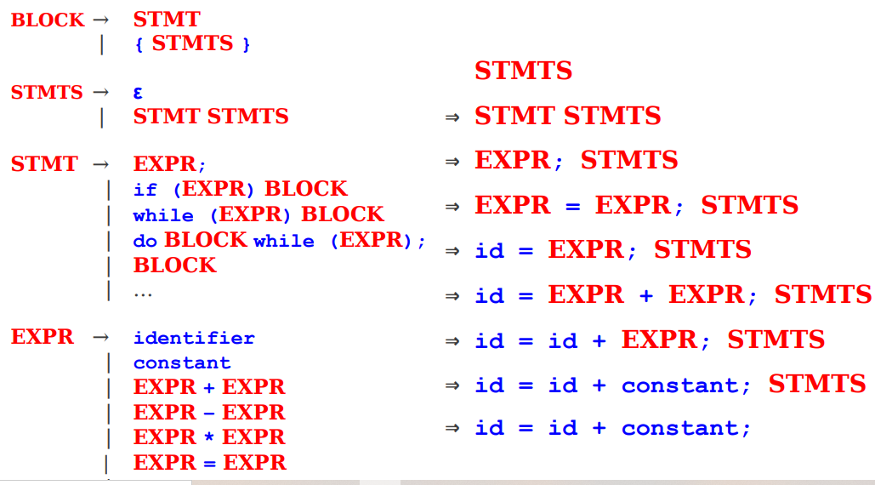
Leftmost Derivation

Slide 12
Parse Tree
Inner nodes of a parse tree are non-terminal symbols.
The leaves of a parse tree are terminal symbols.
A parse tree can be seen as a graphical representation of a derivation.
E ⇒ -E
E
⇒ -(E)
E
E
⇒ -(E+E)
-
E
-
E
-
E
(
E
)
(
E
)
E
E
E
+
E
-
E
-
E
⇒ -(id+E)
⇒ -(id+id)
(
E
)
(
E
)
E
+
E
E
+
E
id
id
id

Slide 13
Ambiguity
A grammar produces more than one parse tree for a sentence is
called as an ambiguous grammar.
E
E ⇒ E+E ⇒ id+E ⇒ id+E*E
⇒ id+id*E ⇒ id+id*id
E
+
E
id
E
*
E
id
id
E ⇒ E*E ⇒ E+E*E ⇒ id+E*E
⇒ id+id*E ⇒ id+id*id
E
E
*
E
E
+
E
id
id
id

Slide 14
Ambiguity (cont.)
For the most parsers, the grammar must be unambiguous.
unambiguous grammar
➔ unique selection of the parse tree for a sentence
We should eliminate the ambiguity in the grammar during the design phase of the compiler.
An unambiguous grammar should be written to eliminate the ambiguity.
We have to prefer one of the parse trees of a sentence (generated by an ambiguous grammar) to disambiguate that grammar to restrict to this choice.

Slide 15
Ambiguity (cont.)
stmt → if expr then stmt |
if expr then stmt else stmt | otherstmts
if E₁ then if E₂ then S₁ else S₂
stmt
if expr then stmt else stmt
E₁ if expr then stmt S₂
E₂ S₁
stmt
if expr then stmt
E₁ if expr then stmt else stmt
E₂ S₁ S₂
1
2

Slide 16
Ambiguity (cont.)
We prefer the second parse tree (else matches with closest if).
So, we have to disambiguate our grammar to reflect this choice.
The unambiguous grammar will be:
stmt → matchedstmt | unmatchedstmt
matchedstmt → if expr then matchedstmt else matchedstmt | otherstmts
unmatchedstmt → if expr then stmt |
if expr then matchedstmt else unmatchedstmt

Slide 17
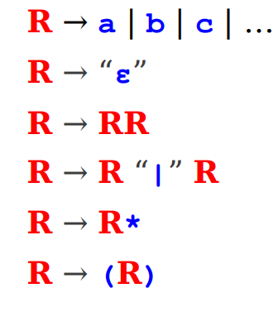
The ambiguity

Slide 18
Precedence Declarations
If we leave the world of pure CFGs, we can often resolve ambiguities through precedence declarations
e.g. multiplication has higher precedence than addition, but lower precedence than exponentiation.
Allows for unambiguous parsing of ambiguous grammars

Slide 19
Abstract Syntax Trees (ASTs)
A parse tree is a concrete syntax tree; it shows exactly how the text was derived.
A more useful structure is an abstract syntax tree, which retains only the essential structure of the input.

Slide 20
How to build an AST?
Typically done through semantic actions.
Associate a piece of code to execute with each production.
As the input is parsed, execute this code to build the AST.
Exact order of code execution depends on the parsing method used.
This is called a syntax-directed translation

Slide 21
Summary
Syntax analysis (parsing) extracts the structure from the tokens produced by the scanner.
Languages are usually specified by context-free grammars (CFGs).
A parse tree shows how a string can be derived from a grammar.
A grammar is ambiguous if it can derive the same string multiple ways.
There is no algorithm for eliminating ambiguity; it must be done by hand.
Abstract syntax trees (ASTs) contain an abstract representation of a program's syntax.
Semantic actions associated with productions can be used to build ASTs.

Slide 22
Parsers
We categorize the parsers into two groups:
Top-Down Parser
the parse tree is created top to bottom, starting from the root.
Beginning with the start symbol, try to guess the productions to apply to end up at the user's program
Bottom-Up Parser
the parse is created bottom to top; starting from the leaves
Beginning with the user's program, try to apply productions in reverse to convert the program back into the start symbol

Slide 23
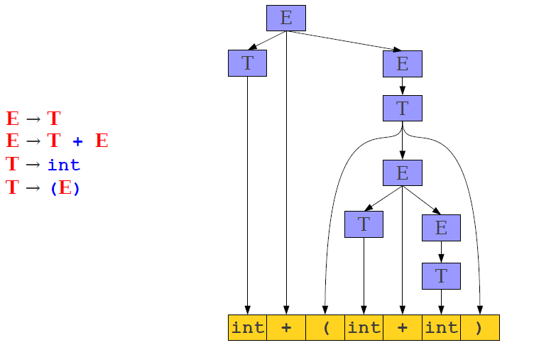
Top Down Parser
E ➔ T + E
E ➔ int + T
E ➔ int + (E)
E ➔ int + (T + E)
E ➔ int + (int + T)
E ➔ int + (int +int)

Slide 24
Challenges in Top-Down Parsing
Top-down parsing begins with virtually no information.
Begins with just the start symbol, which matches every program
How can we know which productions to apply?
In general, we can't.
There are some grammars for which the best we can do is guess and backtrack if we're wrong.
If we have to guess, how do we do it?
.

Slide 25
Parsing as a Search
An idea: treat parsing as a graph search.
Each node is a sentential form (a string of terminals and nonterminals derivable from the start symbol).
There is an edge from node α to node β iff α ⇒ β.

Slide 26
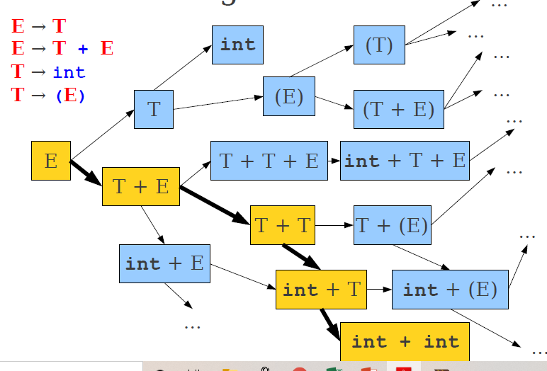
Parsing as a search

Slide 27
Top Down Approach
Breadth-First Search
Maintain a worklist of sentential forms, initially just the start symbol S.
While the worklist isn't empty:
Remove an element from the worklist.
If it matches the target string, you're done.
Otherwise, for each possible string that can be derived in one step, add that string to the worklist.
Can recover a parse tree by tracking what productions we applied at each step.

Slide 28
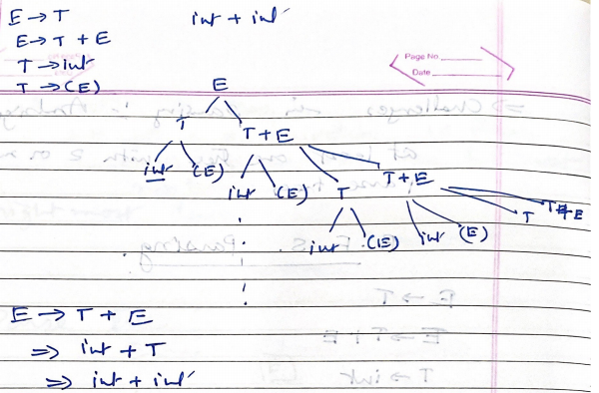
BFS Example:

Slide 29
BFS is Slow
Enormous time and memory usage:
● Lots of wasted effort:
Generates a lot of sentential forms that couldn't possibly match.
But in general, extremely hard to tell whether a sentential form can match – that's the job of parsing!
● High branching factor:
Each sentential form can expand in (potentially) many ways for each nonterminal it contains.

Slide 30
Reducing Wasted Effort
Suppose we're trying to match a string X.
Suppose we have a sentential form T = aB, where a is a string of terminals and B is a string of terminals and non terminals.
If a isn't a prefix of X, then no string derived from T can ever match X.
If we can find a way to try to get a prefix of terminals at the front of our sentential forms, then we can start pruning out impossible options.

Slide 31
Reducing the Branching Factor
If a string has many non terminals in it, the branching factor can be high.
Sum of the number of productions of each nonterminal involved.
If we can restrict which productions we apply, we can keep the branching factor lower.

Slide 32
Leftmost Derivations
Recall: A leftmost derivation is one where we always expand the leftmost symbol first.
Updated algorithm:
Do a breadth-first search, only considering leftmost derivations.
Drops branching factor.
Increases likelihood that we get a prefix of non terminals.
Prune sentential forms that can't possibly match.
Avoids wasted effort

Slide 33
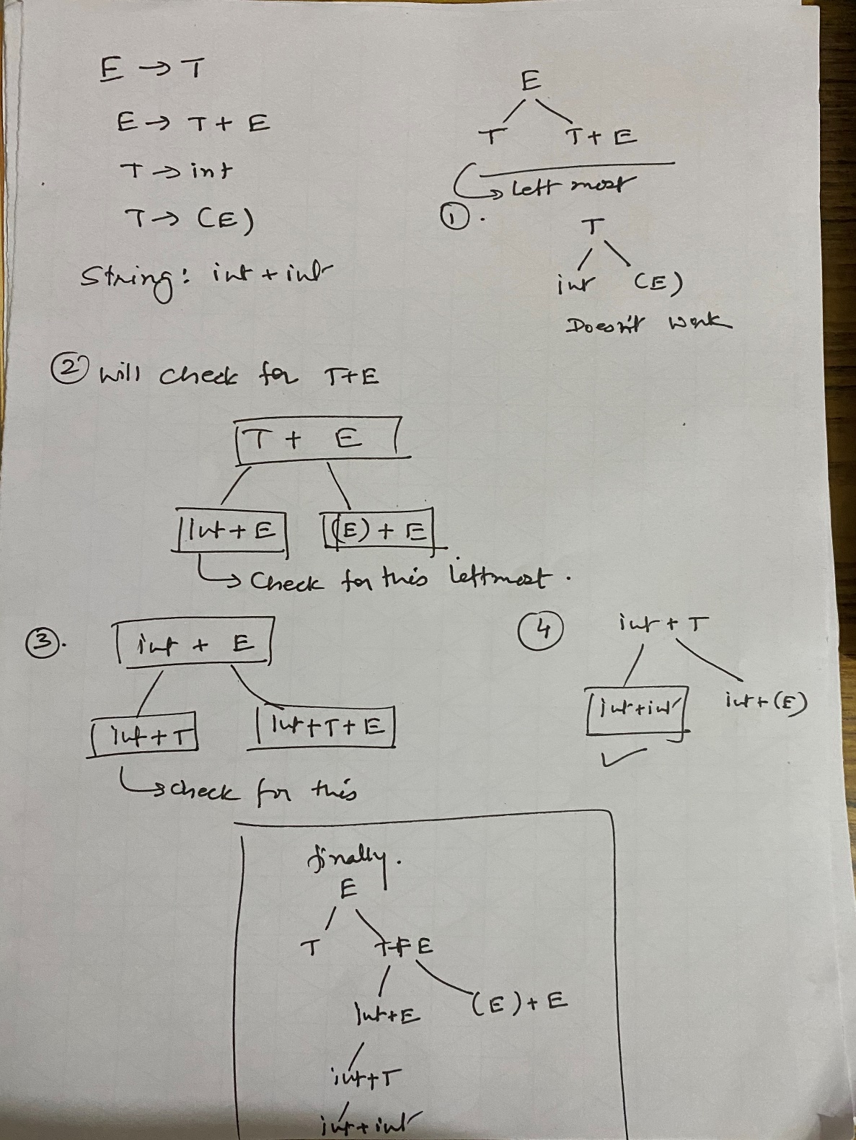
Leftmost derivation example:
E → T
E → T + E
T → int
T → (E)
String: int + int

Slide 34
Leftmost BFS
Substantial improvement over previous method.
Will always find a valid parse of a program if one exists.
Can easily be modified to find if a program can't be parsed.
But, there are still problems. Grammar like
A → Aa | Ab | c creates exponential time and memory for the string: caaaaaaaaa
Go for another approach

Slide 35
Leftmost DFS
Idea: Use depth-first search.
Advantages:
Lower memory usage: Only considers one branch at a time.
High performance: On many grammars, runs very quickly.
Easy to implement: Can be written as a set of mutually recursive functions.

Slide 36
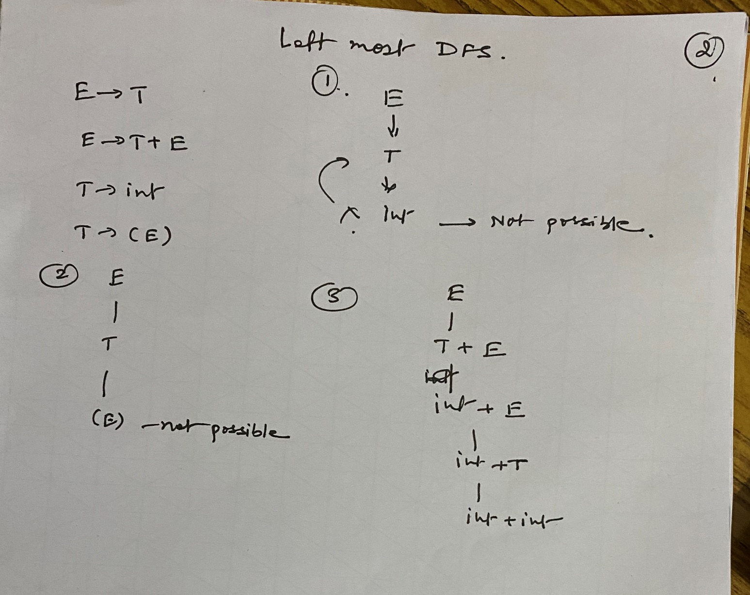
Example:

Slide 37
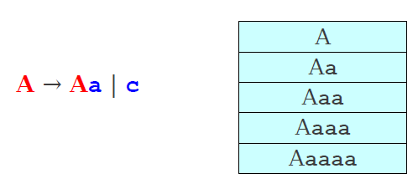
Problems with Leftmost DFS
A non Terminal A is said to be left recursive iff A ➔ Aw for some string w.
Leftmost DFS may fail in left recursive grammar.
It is possible to eliminate left recursion

Slide 38
Summary of Leftmost BFS / DFS
BFS | DFS
Leftmost BFS works on all grammars | Leftmost DFS works on grammars without left recursion.
Worst-case runtime is exponential. | Worst-case runtime is exponential.
Worst-case memory usage is exponential. | Worst-case memory usage is linear.
Rarely used in practice. | Often used in a limited form as recursive descent parser.

Slide 39
Tradeoffs in Prediction
Predictive parsers are fast.
Many predictive algorithms can be made to run in linear time.
Often can be table-driven for extra performance.
Predictive parsers are weak.
Not all grammars can be accepted by predictive parsers.
Trade expressiveness for speed.

Slide 40
Lookahead Symbols
Given just the start symbol, how do you know which productions to use to get to the input program?
Idea: Use lookahead tokens.
When trying to decide which production to use, look at some number of tokens of the input to help make the decision

Slide 41
Predictive Parsing
The leftmost DFS/BFS algorithms are backtracking algorithms.
Guess which production to use, then back up if it doesn't work.
There is another class of parsing algorithms called predictive algorithms.
Based on remaining input, predict (without backtracking) which production to use

Slide 42
Implementing Predictive Parsing
Predictive parsing is only possible if we can predict which production to use given some number of lookahead tokens.
Increasing the number of lookahead tokens, increases the number of grammars we can parse, but complicates the parser.
Decreasing the number of lookahead tokens, decreases the number of grammars we can parse, but simplifies the parser.

Slide 43
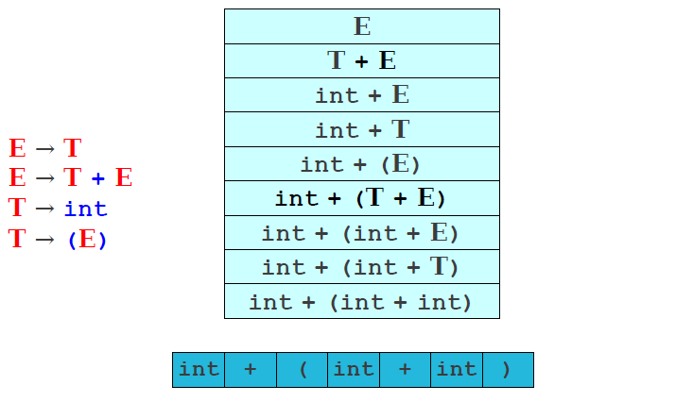
Predictive Parsing

Slide 44
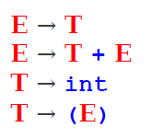
Code for Recursive Descent Parser (RDP)
Procedure E()
: Call Procedure T()
| Call Procedure T(), match “+” , Call Procedure E()
Procedure T()
: match “int”
| match “(“
Call Procedure E,
match “)”

